Slide 1
Goodreads Book recommendation System
Team :
Manita Pasi (002100976)
Anvesh Vatsavai (002190816)
Yash Navadiya (002193912)
Kshitija Laware (002984668)
INFO 7390: Advances Data Science/Architecture, Spring 2023
Professor: Ramkumar Hariharan

Slide 2
Index :
Introduction
Problem statement
Dataset and Statistics
EDA
Preprocessing
Modelling processing
Results
Evaluation and Analysis
Future work

Slide 3
Introduction:
The Goodreads dataset is a large collection of information related to books on the Goodreads website. This dataset contains details on over 6 million books, including title, author, genre, rating, and other metadata. We aim to develop a book recommendation system using five different models and evaluate their performance to select the best one.
Problem Statement:
The current book discovery landscape presents challenges for readers to find high-quality books that match their interests, leading to suboptimal reading experiences. Existing recommendation systems do not effectively utilize book ratings, a key factor in determining quality. To address this issue, the Goodreads Book Recommendation System aims to develop a personalized platform that recommends highly-rated books to users based on their unique taste and reading preferences. By doing so, users can make more informed decisions and enhance their satisfaction, fostering a more vibrant literary community.

Slide 4
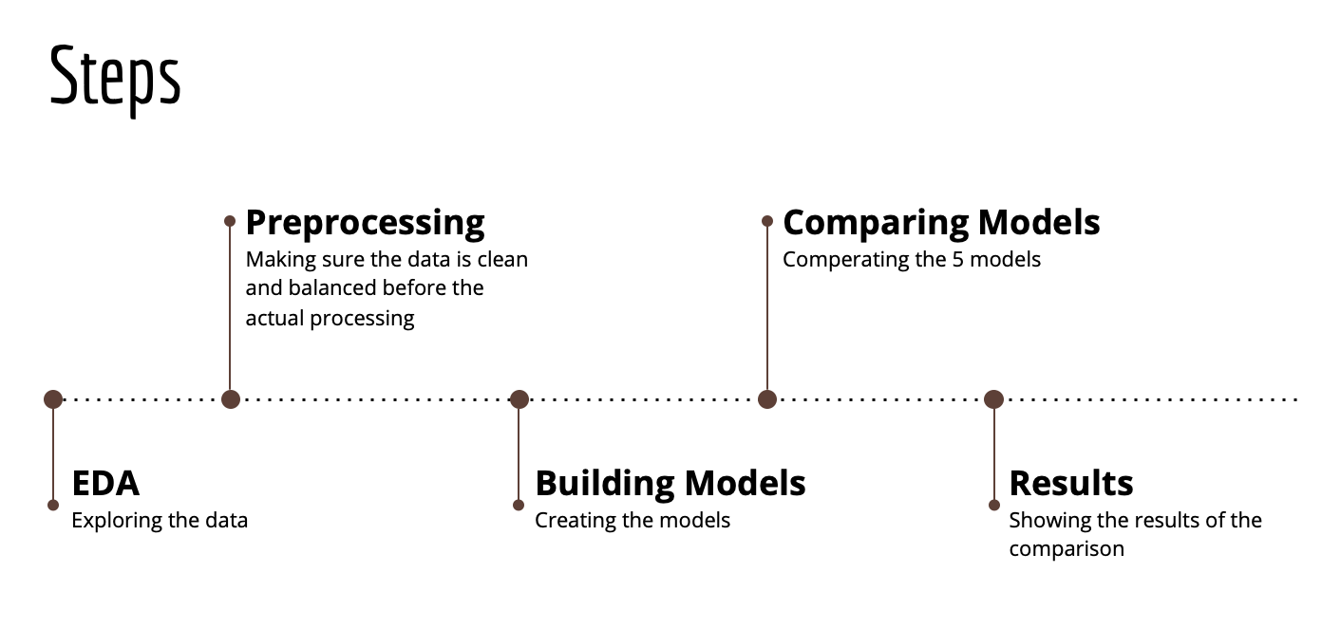
Steps :
Dataset and Statistics :
The dataset is a replica of real world transactional data. The features present here are numeric and anonymized
Total Samples: 13714
Total Features per sample: 39
Feature type: Numerical
Target type: Categorical

Slide 5
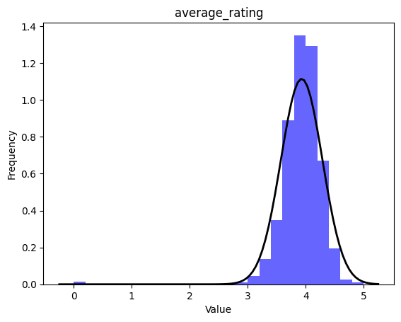
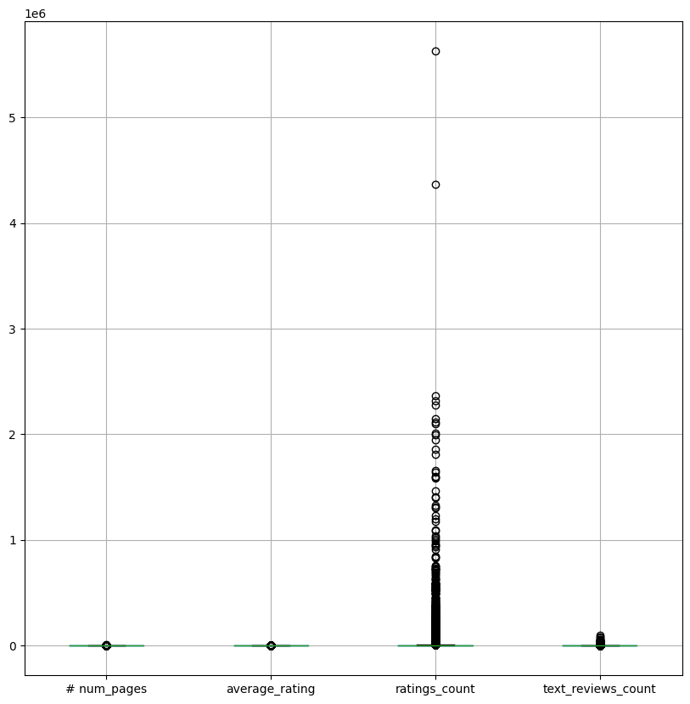
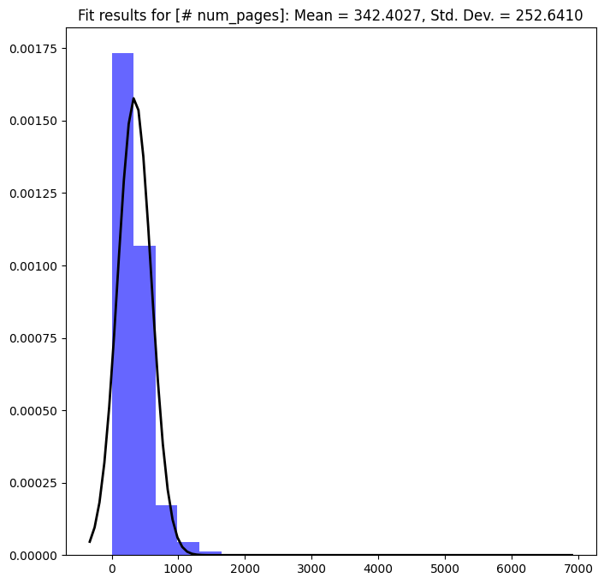
Exploratory data analysis :
Analysis : We began our analysis by examining the distribution type for average ratings, ratings count and number of pages of a book by drawing a normal curve on the histograms and also by using box plot to detect variables with outliers. The histogram shows that the majority of books in the dataset have a rating between 3.5 and 4.5, with a peak at 4. The graphs below shows the analysis.

Slide 6
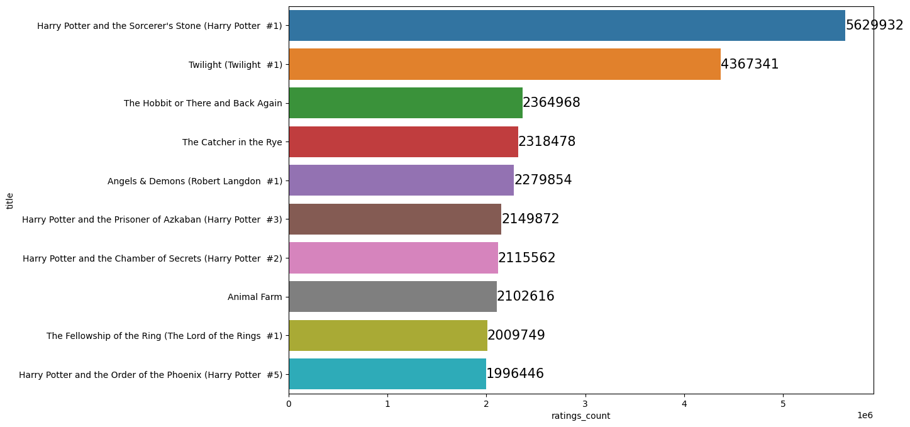
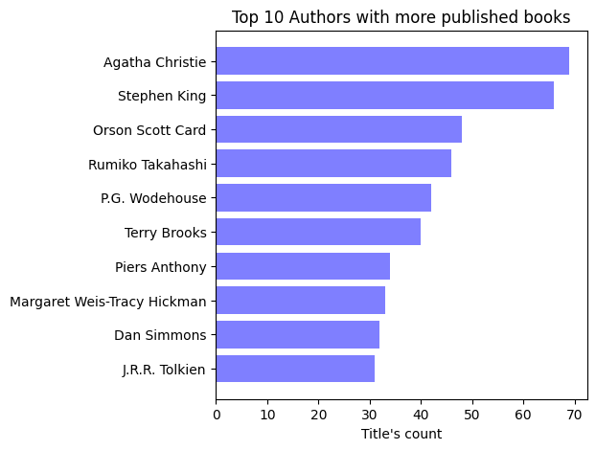
EDA :
Next, we wanted to identify the top 10 books with highest ratings and ratings count and top 10 authors with most books. The plot below shows the top 10 books and authors in our dataset.

Slide 7
Preprocessing :
Create feature 1 : total number of books per author
Create feature 2 : book title length
Extract publication year from title
Create feature 3 : average rating bin
Replace missing values in publication_year with median value
Drop unnecessary columns
Convert publication_year and num_pages to integers
Create classes for average rating bin
Perform data resampling for modeling preparation
Model Process :
Predict book recommendations using classification models:
Models used: XGBoost, SVM, K-Nearest Neighbors, Gaussian Naive Bayes
Apply Grid Validation and hyperparameter tuning
Process:
Split data into training and testing sets
Fit models on training set
Evaluate performance on testing set
Performance metrics:
Accuracy
Precision
Recall
F1-score
Objective: Identify best model for highest accuracy in predicting book recommendations

Slide 8
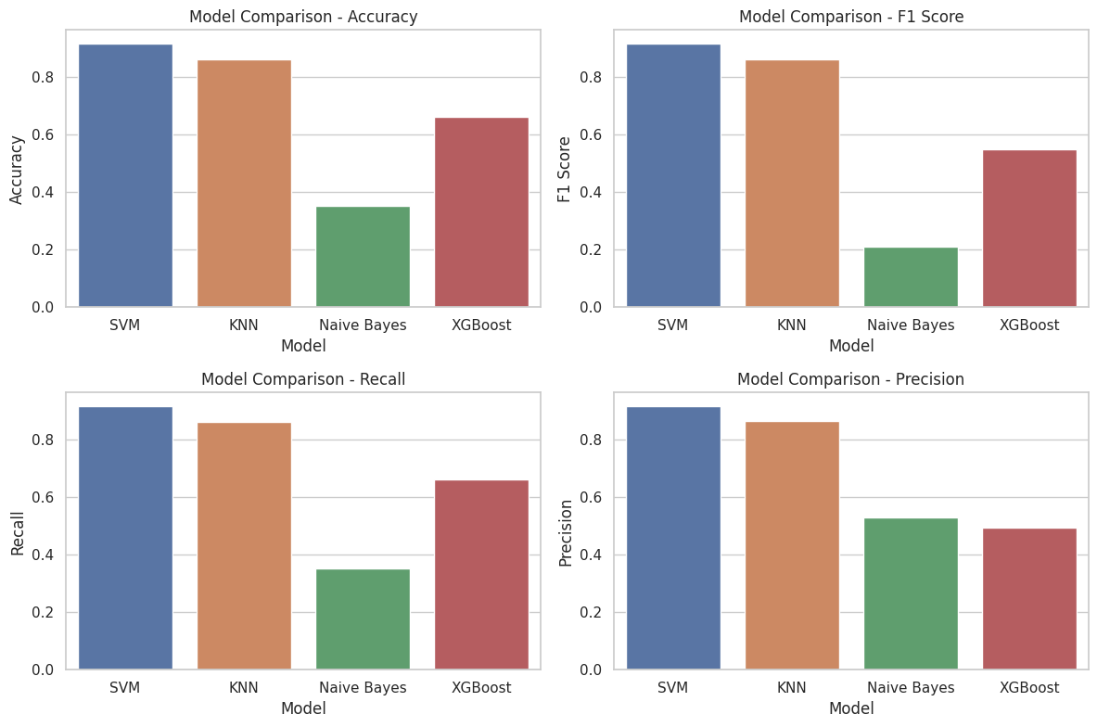
Model Performance :

Slide 9
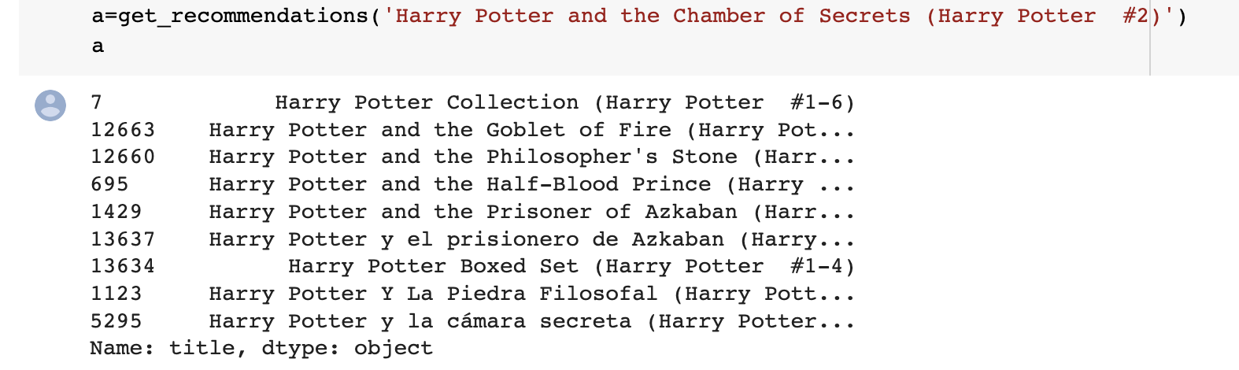
Recommendation System:
For our Goodreads project, we'll develop a Python function using our machine learning model to recommend books. It takes a book name as input and suggests similar books. We employed Content-Based Filtering, considering factors like title, author, and language, and used similarity measures like cosine and Jaccard. Textual features were converted to numerical values using methods like TF-IDF and word embeddings. Our goal is to provide personalized recommendations based on users' past preferences.
The recommended books are listed below :

Slide 10
Results :
We developed a book recommendation system using classification and content-based filtering techniques. SVM achieved the best performance in predicting average book ratings. We used predicted ratings as features for content-based filtering and computed book similarity using cosine similarity. The system was able to recommend highly similar books to the input book. Overall, our system can help users discover new books based on their preferences.
Conclusion :
Our book recommendation system has potential for improvement by adding more features and incorporating user feedback. We could also explore other recommendation techniques for comparison. Our project provides a foundation for building a more advanced system that could benefit bookstores and online retailers in helping customers discover new books that match their interests.

